Slide 1
Knowledge, Reasoning, and Planning
Course Code: AFI 124
Notes:
Pg 409
https://mucertification.com/lessons/module-3-knowledge-reasoning-and-planning/

Slide 2
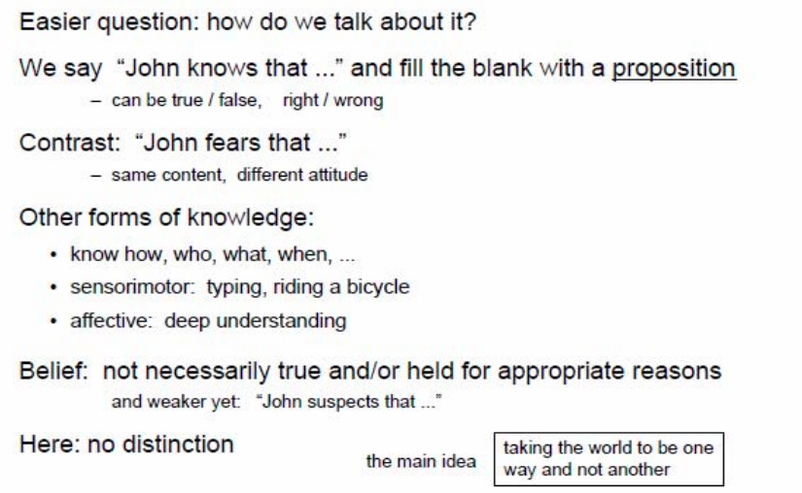
Knowledge

Slide 3
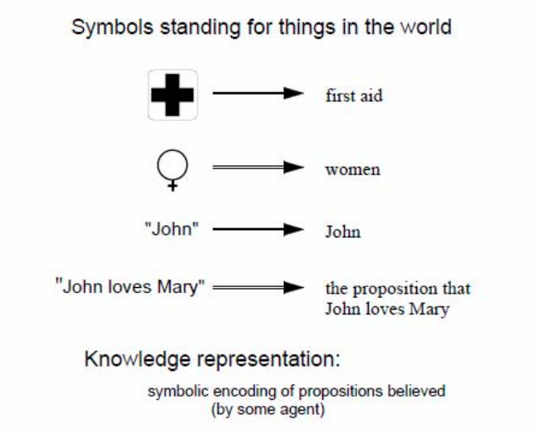
Representation

Slide 4
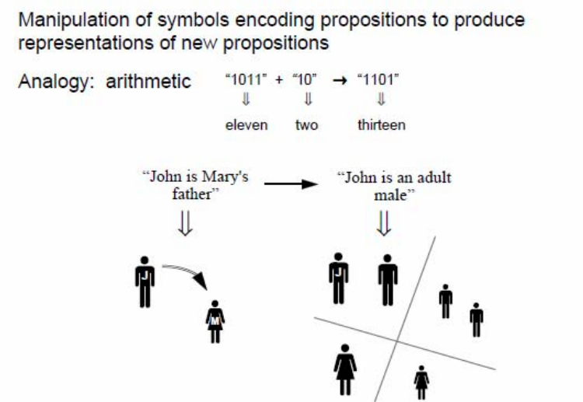
Reasoning

Slide 5
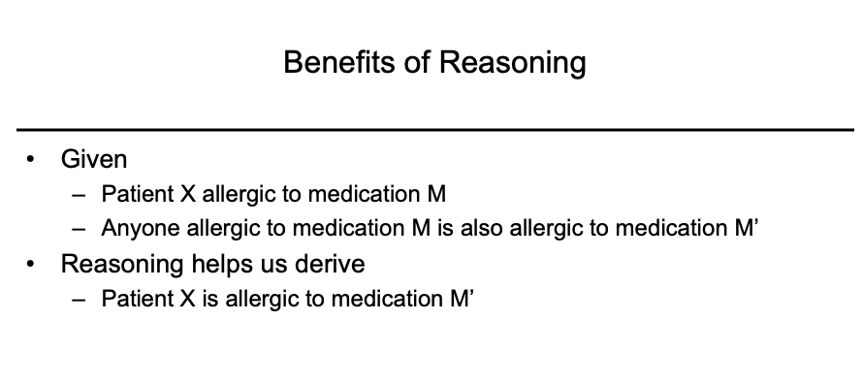

Slide 6
Logical Agents
Agents with some representation of complex knowledge about the world/environment and uses inference(with the help of old knowledge, taking new inputs and generating new concepts) to deliver new information from the knowledge combined with new inputs.

Slide 7
Knowledge based agents
Knowledge base is a set of sentences in a formal language representing facts of the world.
Intelligent agents need knowledge about the world to choose good actions/decisions.
Knowledge = {sentences} in a knowledge representation language
A sentence is an assertion about the world
A knowledge based agent is composed of:
Knowledge based
Inference mechanism

Slide 8
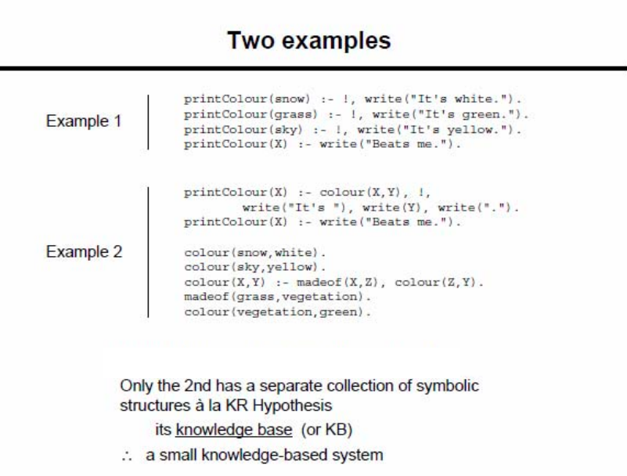

Slide 9
Knowledge Representation Systems
Knowledge Representation in AI describes the representation of knowledge. Basically, it is a study of how the beliefs, intentions, and judgments of an intelligent agent can be expressed suitably for automated reasoning. One of the primary purposes of Knowledge Representation includes modeling intelligent behavior for an agent.
Knowledge Representation and Reasoning (KR, KRR) represents information from the real world for a computer to understand and then utilize this knowledge to solve complex real-life problems like communicating with human beings in natural language. Knowledge representation in AI is not just about storing data in a database, it allows a machine to learn from that knowledge and behave intelligently like a human being.

Slide 10
Properties of Knowledge Representation Systems
The following properties should be possessed by a knowledge representation system.
Representational Adequacy
-- the ability to represent the required knowledge;
Inferential Adequacy
- the ability to manipulate the knowledge represented to produce new knowledge corresponding to that inferred from the original;
Inferential Efficiency
- the ability to direct the inferential mechanisms into the most productive directions by storing appropriate guides;
Acquisitional Efficiency
- the ability to acquire new knowledge using automatic methods wherever possible rather than reliance on human intervention.

Slide 11
Types of Knowledge Representation Systems
Semantic Nets,
Frames,
Conceptual Dependencies
Scripts
Rule Based Systems
Notes:
https://www.brainkart.com/article/Types-of-Knowledge-Representation_8892/

Slide 12
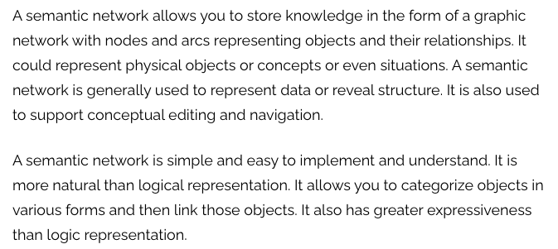
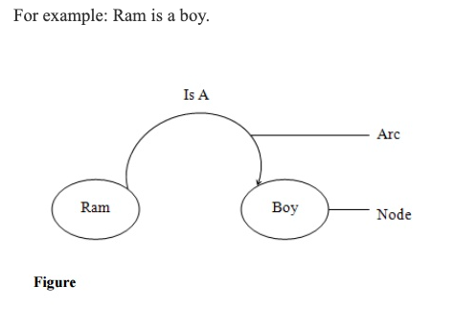
Types of Knowledge Representation Systems: Semantic Nets

Slide 13
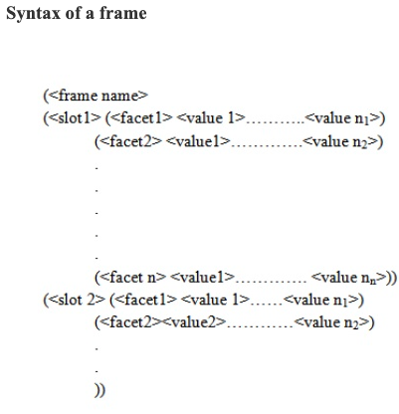
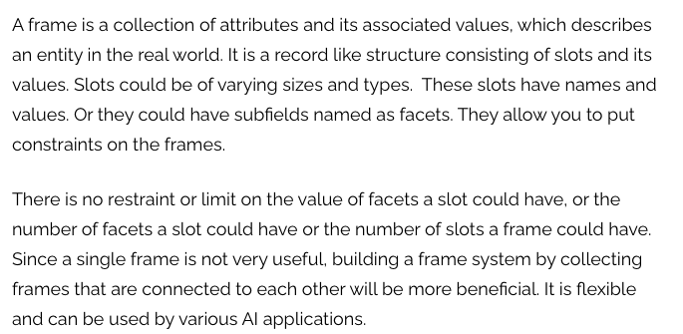
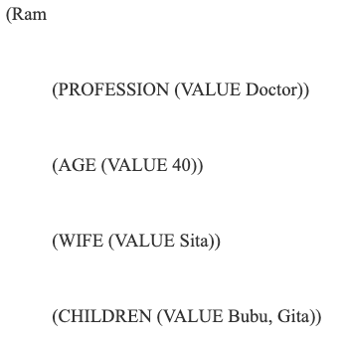
Types of Knowledge Representation Systems: Frames

Slide 14
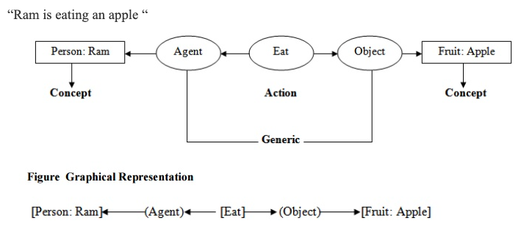
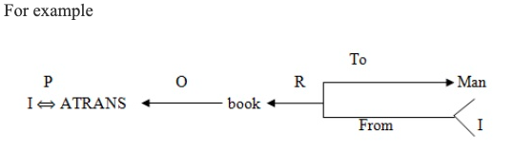
Types of Knowledge Representation Systems: Conceptual Dependencies
Conceptual Graph: It is a knowledge representation technique which consists of basic concepts and the relationship between them. As the name indicates, it tries to capture the concepts about the events and represents them in the form of a graph. A concept may be individual or generic. An individual concept has a type field followed by a reference field. For example person : Ram. Here person indicates type and Ram indicates reference.
Conceptual Dependency: It is an another knowledge representation technique in which we can represent any kind of knowledge. It is based on the use of a limited number of primitive concepts and rules of formation to represent any natural language statement. Conceptual dependency theory is based on the use of knowledge representation methodology was primarily developed to understand and represent natural language structures. The conceptual dependency structures were originally developed by Roger C SChank in 1977.

Slide 15
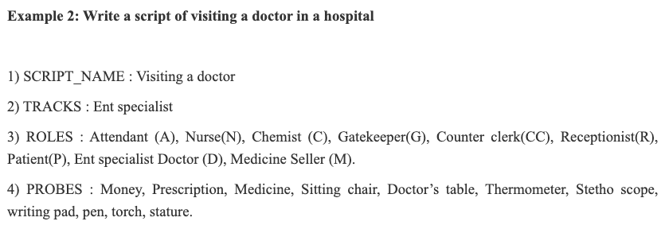
Types of Knowledge Representation Systems: Scripts
It is an another knowledge representation technique. Scripts are frame like structures used to represent commonly occurring experiences such as going to restaurant, visiting a doctor. A script is a structure that describes a stereotyped sequence of events in a particular context. A script consist of a set of slots. Associated with each slot may be some information about what kinds of values it may contain as well as a default value to be used if no other information is available. Scripts are useful because in the real world, there are no patterns to the occurrence of events. These patterns arise because of clausal relationships between events. The events described in a script form a giant casual chain. The beginning of the chain is the set of entry conditions which enable the first events of the script to occur. The end of the chain is the set of results which may enable later events to occur. The headers of a script can all serve as indicators that the script should be activated.
Once a script has been activated, there are a variety of ways in which it can be useful in interpreting a particular situation. A script has the ability to predict events that has not explicitly been observed. An important use of scripts is to provide a way of building a single coherent interpretation from a collection of observation. Scripts are less general structures than are frames and so are not suitable for representing all kinds of knowledge. Scripts are very useful for representing the specific kinds of knowledge for which they were designed.

Slide 16
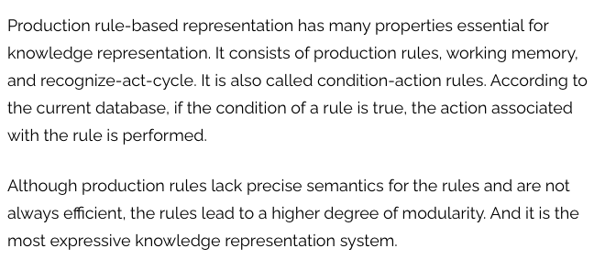
Types of Knowledge Representation Systems: Rule Based Systems

Slide 17
Propositional Logic
A proposition is a declarative sentence with a truth value. Truth value can be either true or untrue, but it must be assigned to one of the discrete choices and not be unclear. The goal of using predicate logic is to analyze a statement, either individually or in aggregate.
In simple Terms,
The literal meaning of a proposition is to put across one’s views, ideas, suggestions, expression or judgment. The proposition can be done through a formal document or oral communication (Informal). It can either address a positive or negative connotation.
A proposition in logic includes Boolean functionalities in a sentence to make it either True or False and also adds reasoning techniques and proofing methods to make it much more comprehensive. This logic is a very old and widely adopted one.
This logic was readily embraced by the modern search algorithm in Artificial Intelligence applications and Computer-aided tools. It’s use cases in AI include planning, decision making, smart control, diagnosis and problem-solving areas in Business, Medical, Education fields.

Slide 18
Propositional Logic
Syntax,
Semantics,
Formal logic -connectives,
truth tables,
tautology,
validity,
well -formed -formula,
Inference using Resolution,
Backward Chaining and Forward Chaining

Slide 19
Propositional Logic:Syntax
The syntax of propositional logic defines the allowable sentences. The atomic sentences consist of a single proposition symbol. Each such symbol stands for a proposition that can be true or false. We use symbols that start with an uppercase letter and may contain other letters or subscripts, for example: , , , , and FacingEast. The names are arbitrary but are often chosen to have some mnemonic value.
There are two proposition symbols with fixed meanings: True is the always-true proposition and False is the always-false proposition.
^, v, →, ↔, ¬ are used to represent AND, OR,Implies, bi-conditional and NOT condition.

Slide 20

Propositional Logic:Semantics
The semantics defines the rules for determining the truth of a sentence with respect to a particular model. In propositional logic, a model simply sets the truth value—true or false— for every proposition symbol. For example, if the sentences in the knowledge base make use of the proposition symbols , and , then one possible model is

Slide 21
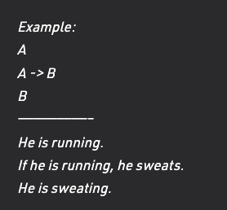
Forward Chaining and Back
Forward Chaining and Backward Chaining are the two most important strategies in the field of Artificial Intelligence and lie in the Expert System Domain of AI. Forward and Backward chaining is the strategies used by the Inference Engine in making the deductions.
Inference Engine:
Inference Engine is a component of the expert system that applies logical rules to the knowledge base to deduce new information. It interprets and evaluates the facts in the knowledge base in order to provide an answer.
A knowledgebase is a structured collection of facts about the system’s domain.
Forward Chaining:
Forward Chaining the Inference Engine goes through all the facts, conditions and derivations before deducing the outcome i.e When based on available data a decision is taken then the process is called as Forwarding chaining, It works from an initial state and reaches to the goal(final decision).

Slide 22
Backward Chaining
In this, the inference system knows the final decision or goal, this system starts from the goal and works backwards to determine what facts must be asserted so that the goal can be achieved, i.e it works from goal(final decision) and reaches the initial state.
Example:
B
A -> B
A
—————————–
He is sweating.
If he is running, he sweats.
He is running.

Slide 23
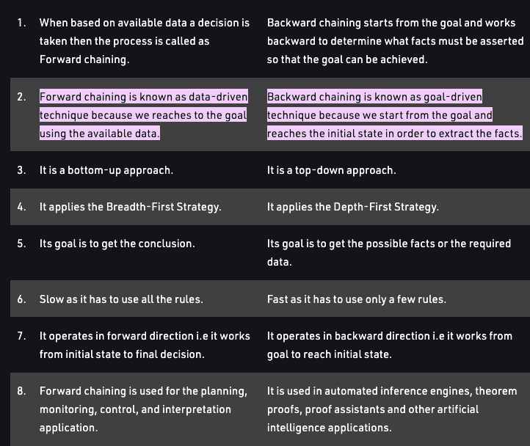
Difference between Forward and Backward Chaining

Slide 24
To be Contd..

Slide 25
Predicate Logic
in propositional logic, we can only represent the facts, which are either true or false. PL is not sufficient to represent the complex sentences or natural language statements. so we required some more powerful logic, such as first-order logic.
The basic syntactic elements of first-order logic are the symbols that stand for objects, relations, and functions. The symbols, therefore, come in three kinds:
constant symbols, which stand for objects;
predicate symbols, which stand for relations; and
function symbols, which stand for functions.
NOTE: (First-order logic—also known as predicate logic)

Slide 26
Predicate Logic also known as First Order Logic
First-order logic (like natural language) does not only assume that the world contains facts like propositional logic but also assumes the following things in the world:
Objects: A, B, people, numbers, colors, wars, theories, squares, pits, wumpus, ......
Relations: It can be unary relation such as: red, round, is adjacent, or n-any relation such as: the sister of, brother of, has color, comes between
Function: Father of, best friend, third inning of, end of, ......
Predicate Logic has two such quantifiers: ∀ (the universal quantifier) and ∃ (the existential quantifier). Since a predicate can combine with more than one variable, it is necessary to write the variable immediately after the quantifier to indicate which variable the quantifier interacts with.

Slide 27
Key aspects of knowledge representation languages are:
Syntax has to do with what ‘things’ (symbols, notations) one is allowed to use in the language and in what way; there is/are a(n):
Alphabet
Language constructs
Sentences to assert knowledge
Semantics, Formal meaning, which has to do what those sentences with the alphabet and constructs are supposed to mean.
Notes:
https://eng.libretexts.org/Bookshelves/Computer_Science/Programming_and_Computation_Fundamentals/Book%3A_An_Introduction_to_Ontology_Engineering_(Keet)/03%3A_First_Order_Logic_and_Automated_Reasoning_in_a_Nutshell/3.01%3A_First_Order_Logic_Syntax_and_Semantics

Slide 28
Predicate Logic: Syntax
The syntax tells, how programs must be written, where blanks are allowed, where semi|colons must be written, whether to use brackets or parentheses, etc.), a well|formed expression in a programming language is a program that passed the compiler without úsyntax errorø.

Slide 29
Predicate Logic: Semantics
Semantics refers to the meaning of expressions in a language. The semantics of an expression is based on its syntax, and also the actions that can be attached to an expression~such as proving, computing, and solving~are guided by the syntactical structure of expressions. Hence, a clear understanding of the syntax is the basis, and often the key, for understanding mathematics

Slide 30
Predicate Logic: Quantification
Quantifiers are phrases that refer to given quantities, such as "for some" or "for all" or "for every", indicating how many objects have a certain property.
Two kinds of quantifiers:
– Universal Quantifier: represented by , “for all”, “for every”, “for each”, or “for any”.
∀x ∀y LOVE(x,y) Everything loves everything
– Existential Quantifier: represented by , “for some”, “there exists”, “there is a”, or “for at least one”.
∃x ∃y LOVE(x,y) Something loves something

Slide 31
Inference with FOPL
[chapter 9 Pg 542]
Notes:
Ch 9

Slide 32
Issues in Knowledge Representation
Relationship Issue
Granularity Issue
Attribute Issue
Notes:
https://tutorialbit.com/artificial-intelligence/issues-of-knowledge-representation-in-ai/

Slide 33
NOTES
https://genuinenotes.com/wp-content/uploads/2021/05/unit4.pdf

